Slide 1
WeCare
Submitted in the partial fulfillment for the award of the degree of
BACHELOR OF ENGINEERING
IN
CS205::BE-CSE(H) INFO. SECURITY
Submitted by:
Shrey Jain 19BCS3541
Rishabh Mohata 19BCS3542
Madhav Singh 19BCS3543
Rashita 19BCS3554
Under the Supervision of:
Prof: Monica Luthra
Department of AIT-CSE
DISCOVER . LEARN . EMPOWER

Slide 2
Outline
Introduction to Project
Problem Formulation
Objective
Methodology
Results and Outputs
Conclusion
Future Scope
References

Slide 3
Introduction to Project
Medical chatbot based on Deep Learning, which helps users in order to find the diseases they are suffering from.
Aims to provide a preliminary diagnosis of the disease before going to the doctor.
Suggest medicines related to the particular disease
Provide us with some online link where doctors come for regular online check-ups.

Slide 4
Introduction to Project ( cont. )
Helps user to save chats (with patient details) for future use. It also shows us the day, date and the time when the chat was saved.
Encourages people to know about their health and provides the with diagnosis it has done based on the list of symptoms provided by the user.
Easy to manage, cost effective and time saving

Slide 5
Problem Formulation
In the current scenario, maintaining good health is of most concern.
21st century has now become a century of hustle and fast-paced life, where people are hardly taking time for themselves.
Important to keep a check on your health on a weekly/monthly basis to avoid potentially life-threatening conditions or diseases at an early stage.

Slide 6
Problem Formulation (cont.)
Regular check-ups reduce risk of getting sick and increase chances of proper treatment.
Most people fail to do regular check-ups because of the hectic schedule.
Most of the time, they ignore their mild symptoms which can further become life-threatening.

Slide 7
Objectives
Storing personal and medical data of user in database.
Detection of disease using symptoms.
To suggest websites for online consultation.
Establishing a medical chatbot which cost effective and easy to use.

Slide 8
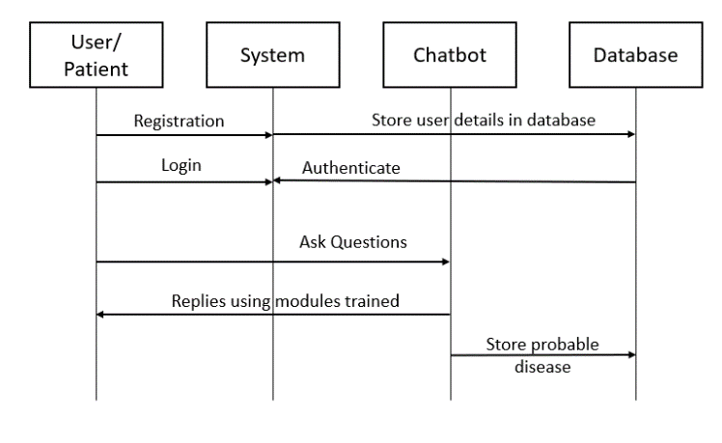
Methodology
Working of chatbot –

Slide 9
Methodology: Natural Language Processing
Computer systems need humans to interact with them in a certain programming language.
But, human language contains a lot of composite variables which makes it very less accurate
NLP is used by computers to analyze, understand, and derive meaning from human language in a useful way

Slide 10
Methodology: Keras
An open-source software library that provides an interface for artificial neural networks in python
Acts as an interface for TensorFlow library
The implementation of the said is done in the following steps:
Creating models.
Compiling model.
Fitting and saving models.

Slide 11
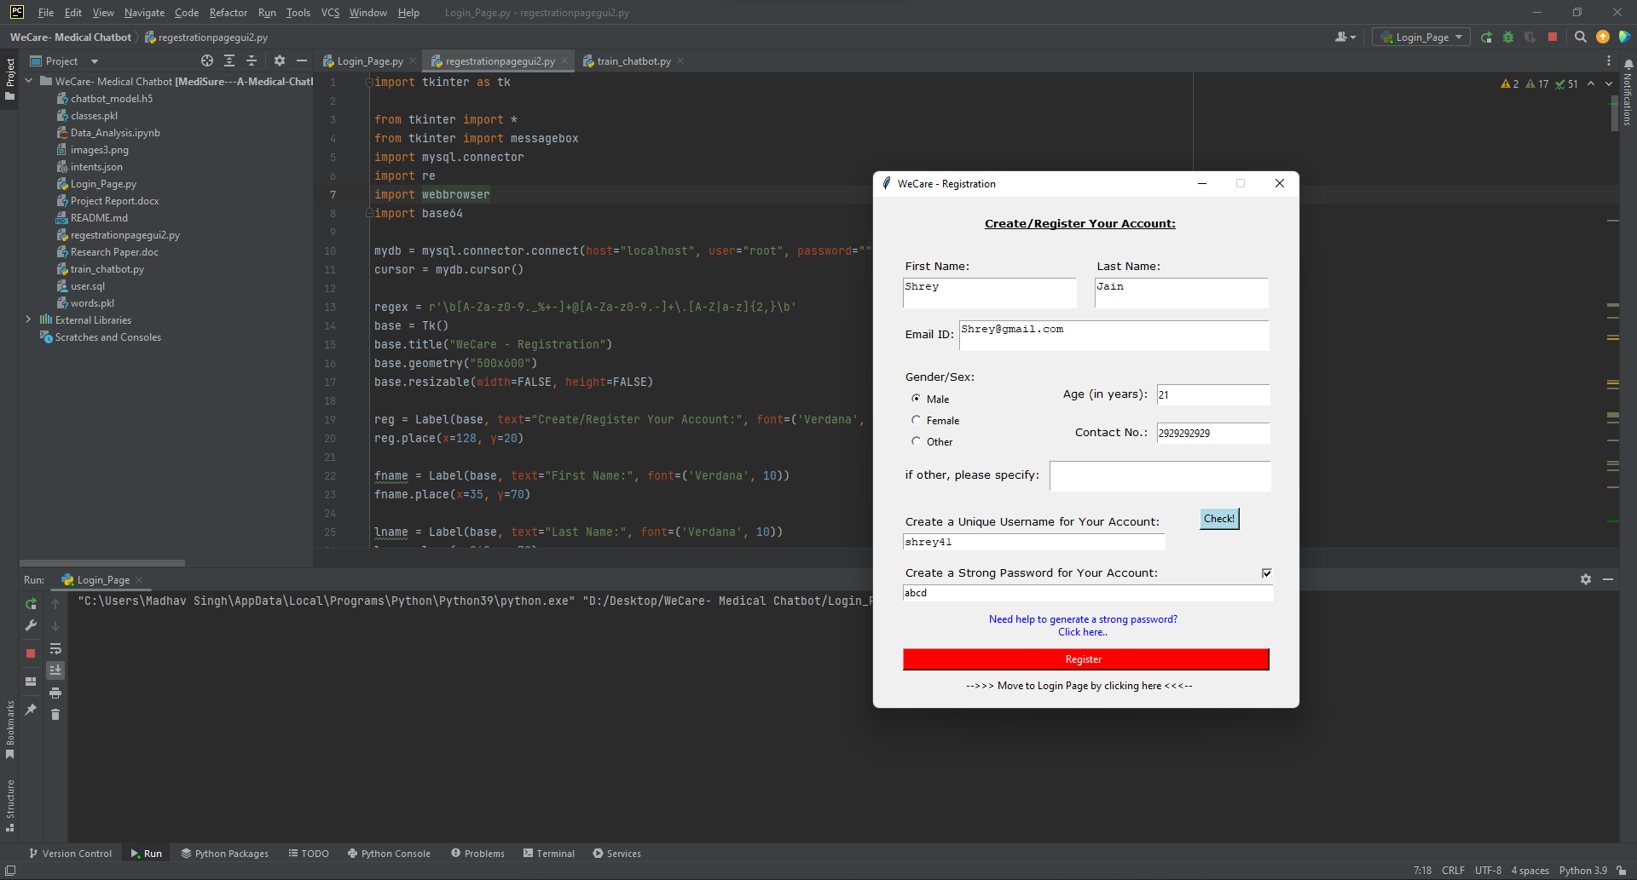
Results and Outputs:

Slide 12
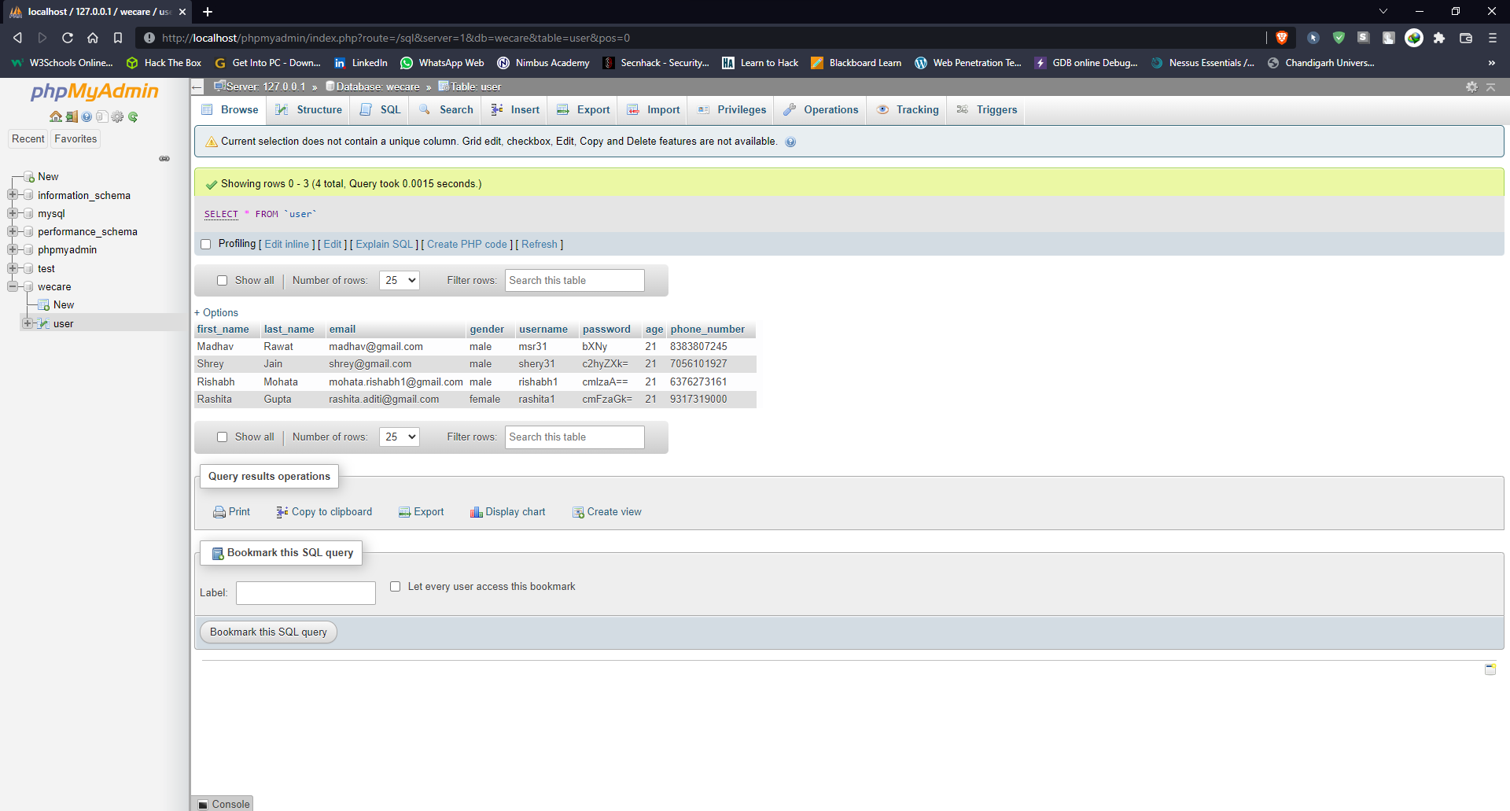
Results and Outputs:

Slide 13
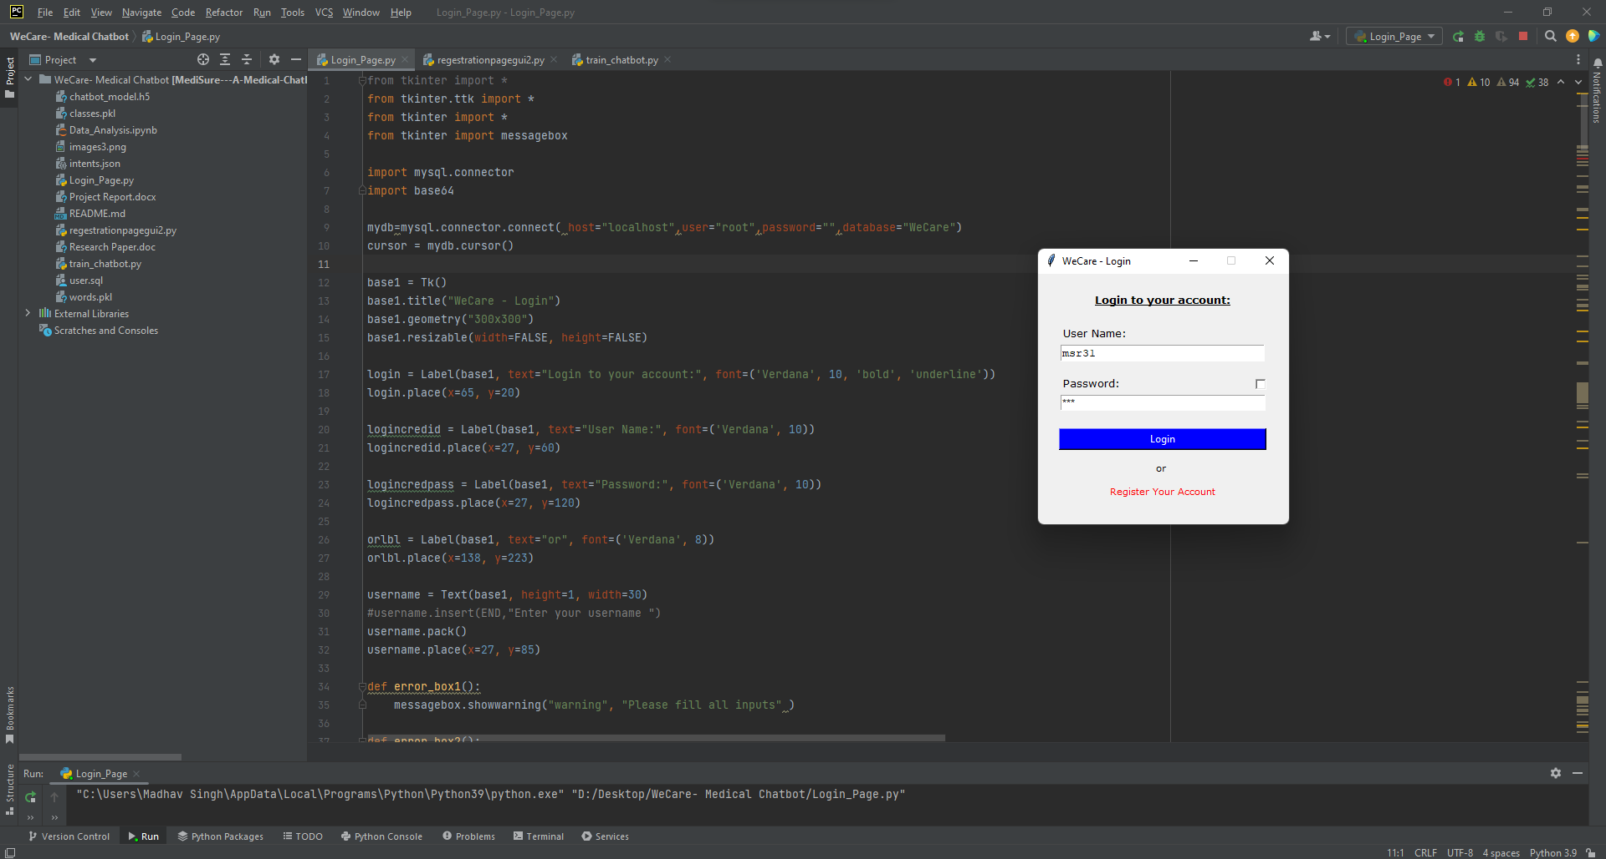
Results and Outputs:

Slide 14
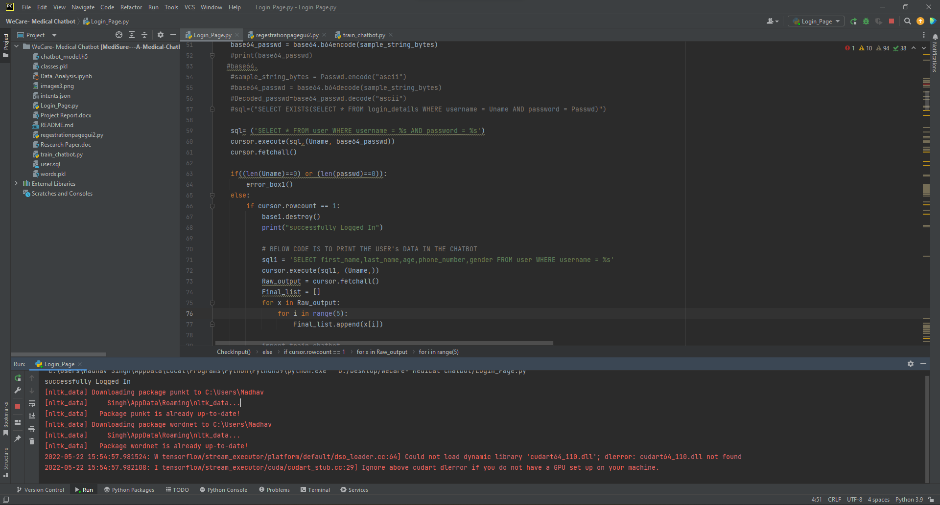
Results and Outputs:

Slide 15
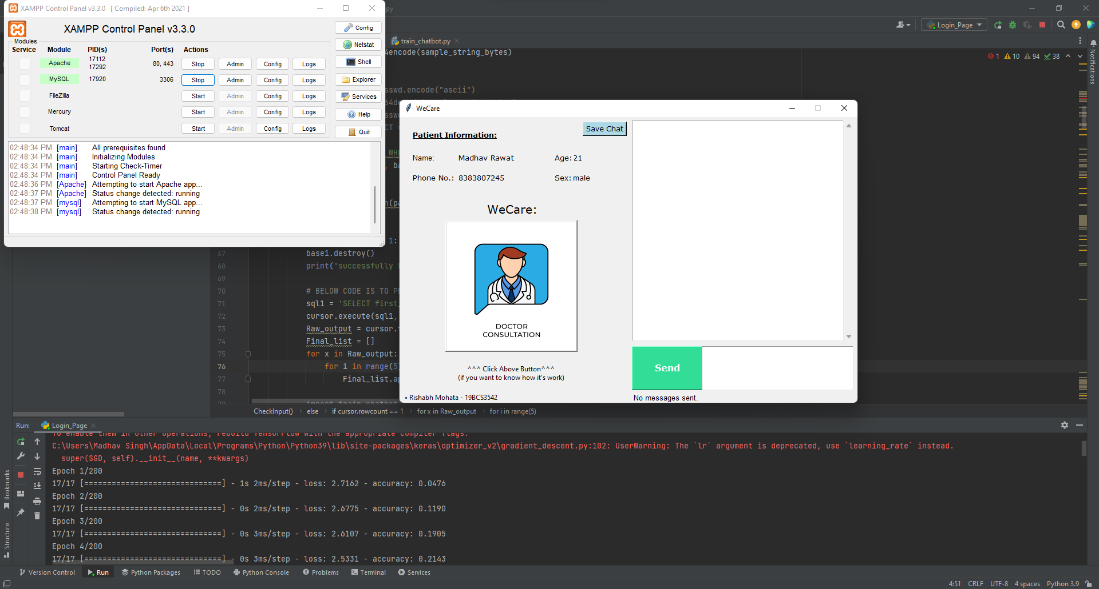
Results and Outputs:

Slide 16
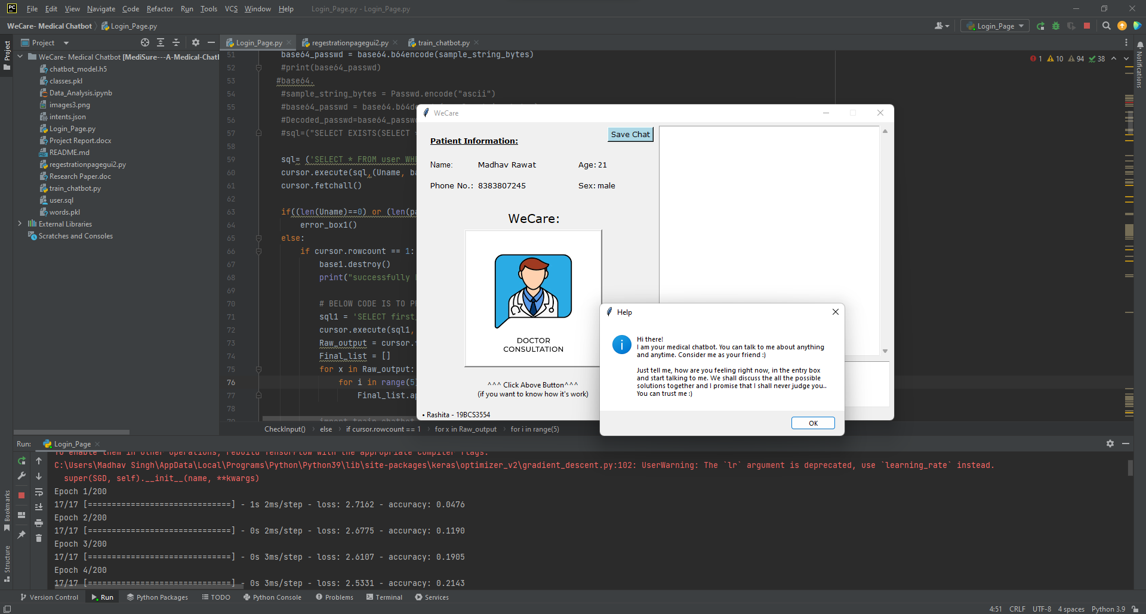
Results and Outputs:

Slide 17
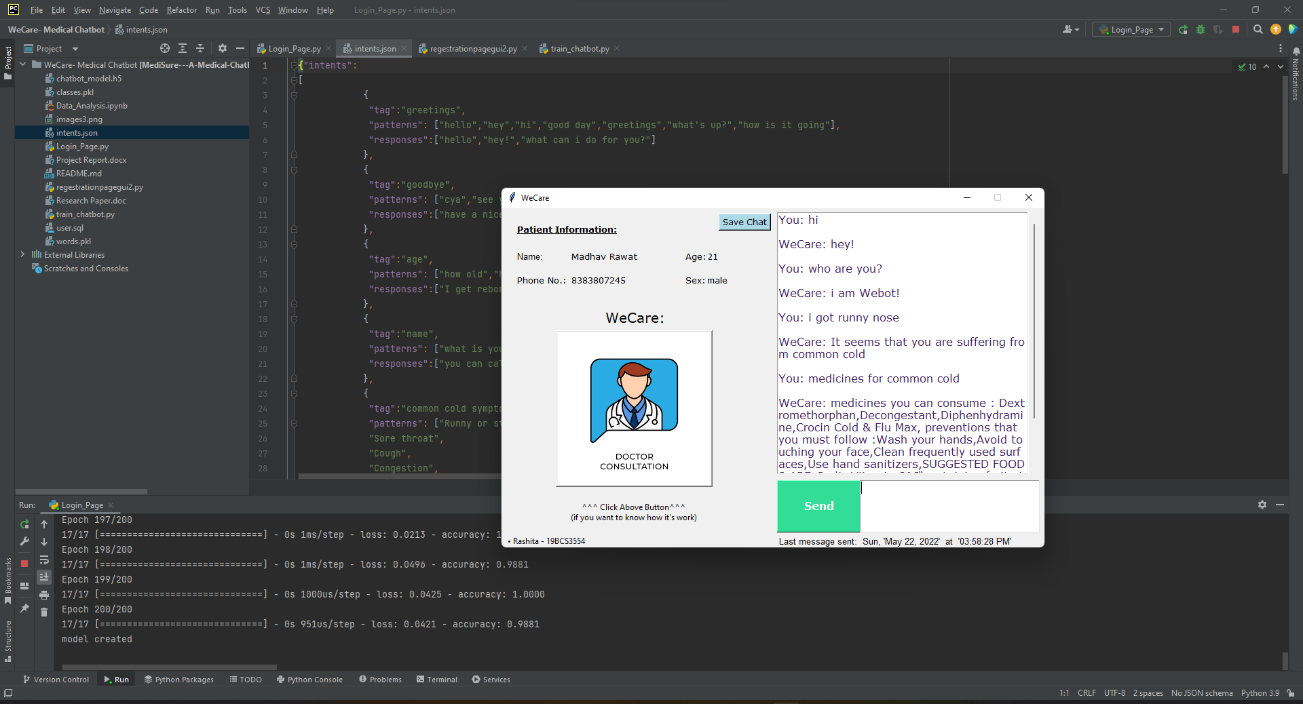
Results and Outputs:

Slide 18
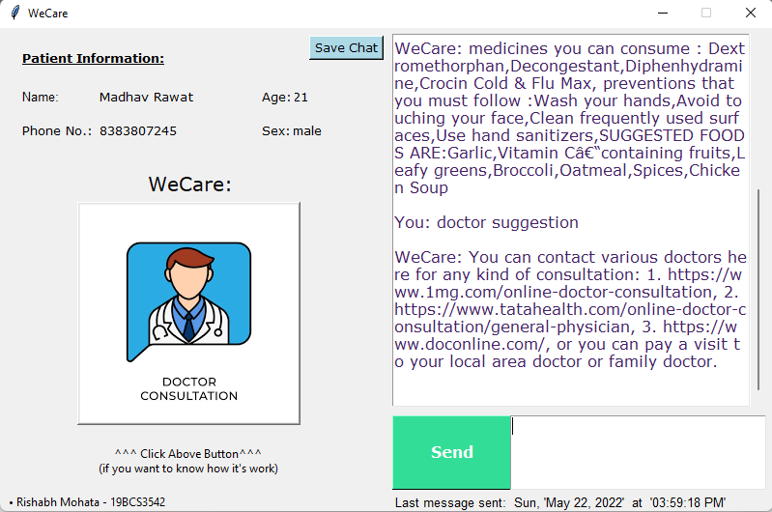
Results and Outputs:

Slide 19
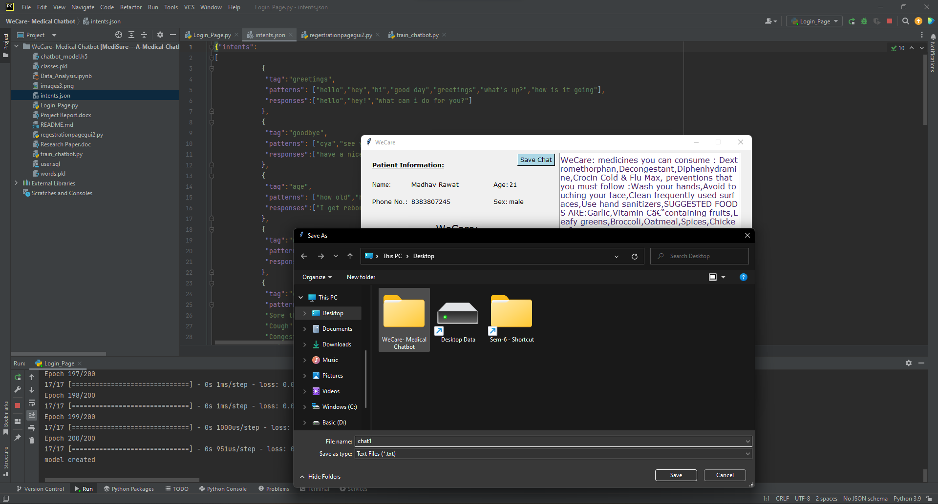
Results and Outputs:

Slide 20
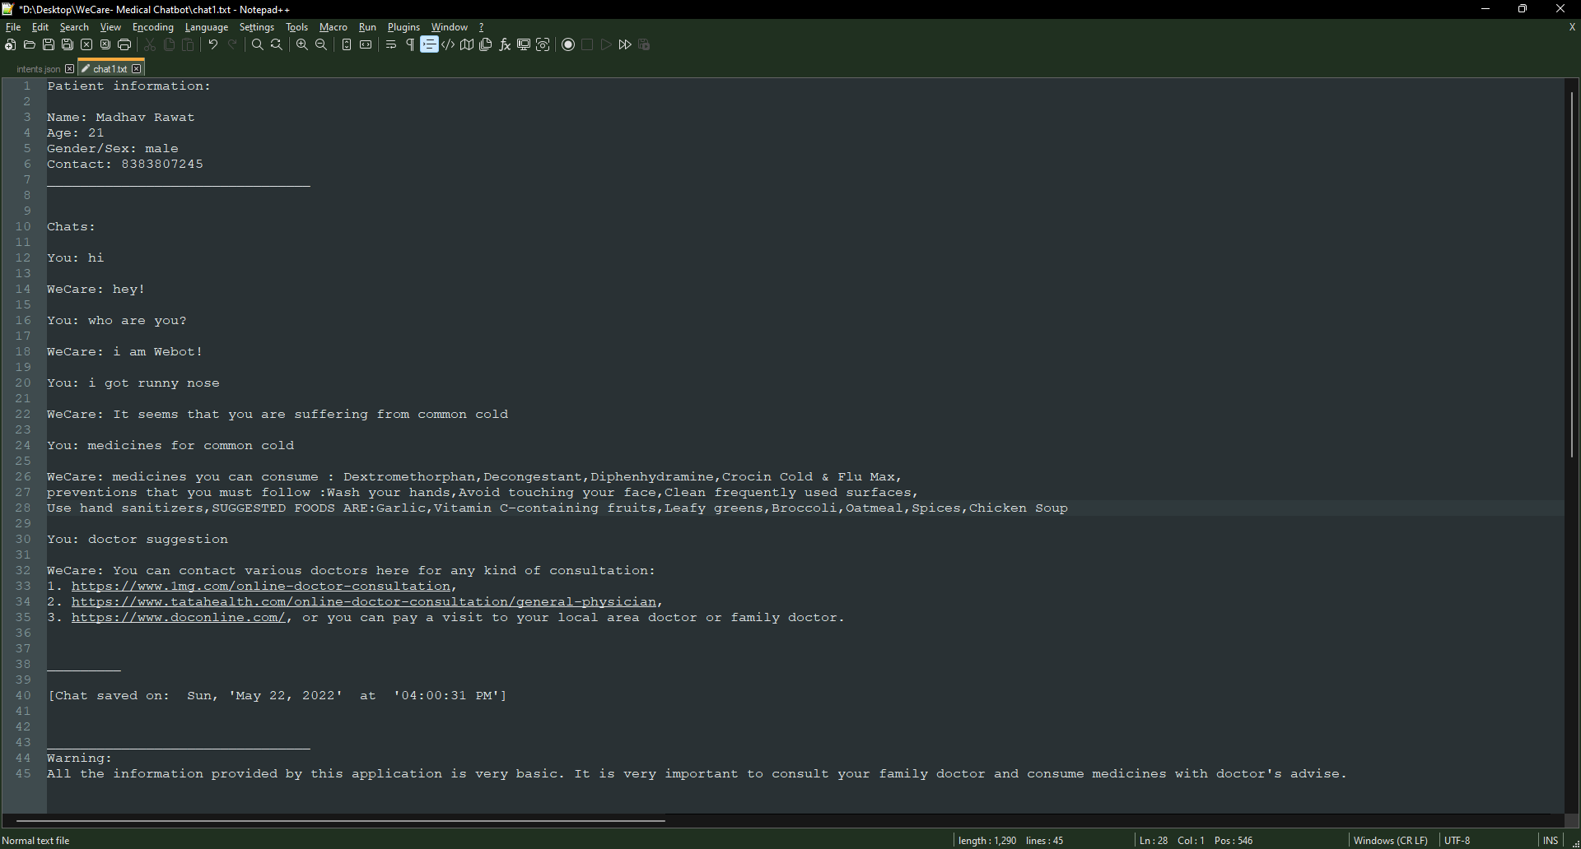
Results and Outputs:

Slide 21
Conclusion
Provide the users an advantage of carrying virtual doctor with them.
Freedom to check the current status of their health 24/7.
Useful to the elderly and physically disabled people as they can get information about their minor health issues at their fingertips.
Not enough datasets available for diseases which limits the number of diseases it can predict.

Slide 22
Future Scope
Bring doctors and medical professionals to this platform to whom can users consult according to the disease diagnosed by the chatbot.
Implement the system into android or iOS so that the users can use the system more conveniently.
The medical details of the user are very confidential and should not be disclosed to anyone. So, the database containing information can be encrypted.
To reduce the difficulty of sending text messages to a chatbot, we can add voice assistant in the system which will make it easier to use.

Slide 23
References
Krishnendu Rarhi, Abhishek Mishra and Krishnasis Mandal , “Automated Medical Chatbot” in SSRN Elecronic Journal, 2017.
Mrs. Asha Rani K P, Mrs. Asha K N, Ranjith Kumar D R, Rohan, Ranjan Raj and Rohini, “Medical Chatbot for Disease Prediction using Machine Learning”, IJARESM, vol. 9, 2021
S. Anil Kumar, C. Vamsi Krishna, P. Nikhila Reddy, B. Rohith Kumar Reddy and I. Jeena Jacob, “Self-Diagnosing Health Care Chatbot using Machine Learning”, IJAST, vol. 29, 2020.
Gajendra Prasad K. C., Satvik Ranjan, Tathagat Ankit, and Vivek Kumar, “A Personalized Medical Assistant Chatbot: MediBot”, IJSTE, vol. 5, 2019.
Dr. Paul Raj, Murali Krishna R, Solleti Manoj Krishna, Koppolu Harsha Vardhan, and Kameswara Rao M, “EMERGENCY PATIENT CARE SYSTEM USING CHATBOT”, IJTRE, vol.6, 2019.
Monica Agrawal, Janette Cheng and Caelin Tran, “What’s Up, Doc? A Medical Diagnosis Bot”.

Slide 24
References
Deepmala Kale and Shailendra Aswale, “Doctor Chatbot: Heart Disease Prediction System”, ITEE, vol.9, 2020.
Prof. Dhomse Kanchan B. and Mr. Mahale Kishor M, “Study of Machine Learning Algorithms for Special Disease Prediction using Principal of Component Analysis”, International Conference on Global Trends in Signal Processing, Information Computing and Communication, 2016.
https://keras.io/
https://www.nltk.org/

